Slide 1
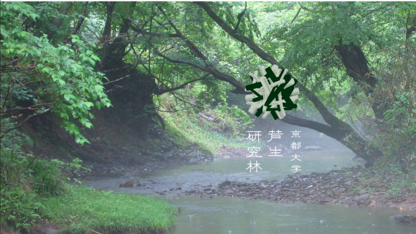
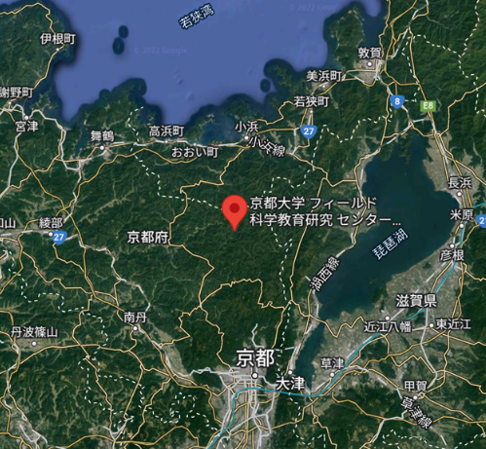
Service Learning B – Ashiu Fieldwork
Guidance 2024
Liang Zhao
Hitoshi Yoshikawa
画像 http://ashiu.kais.kyoto-u.ac.jp/

Slide 2
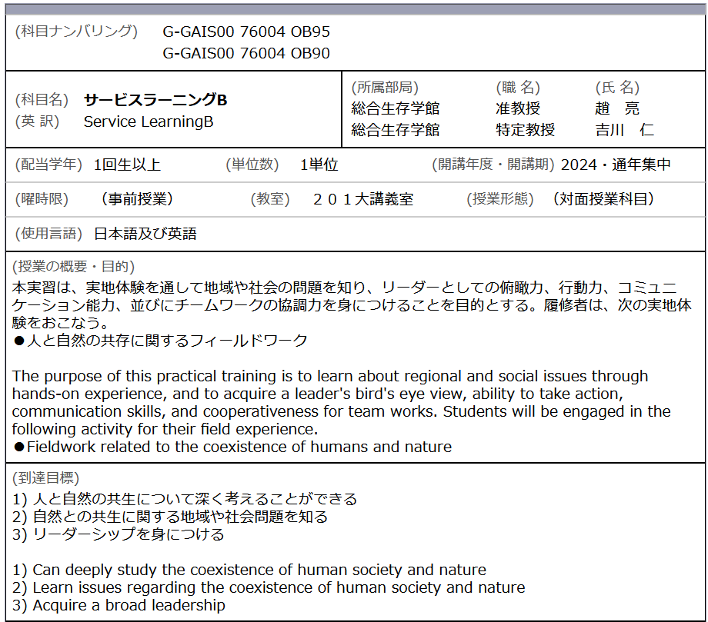

Slide 3
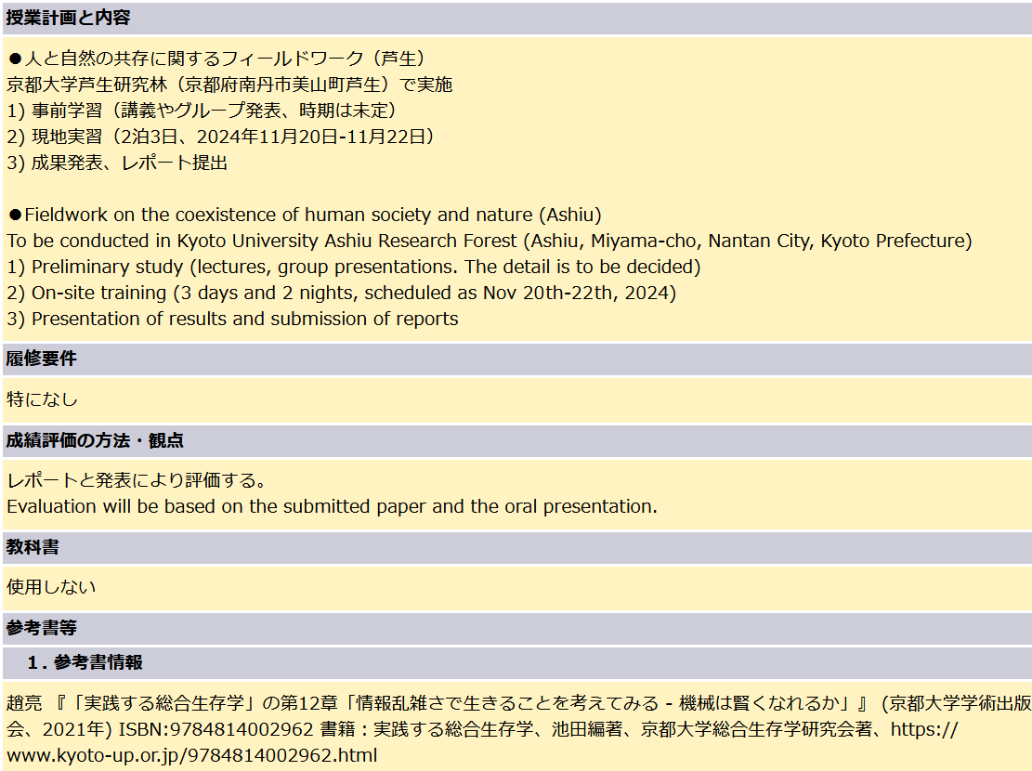

Slide 4
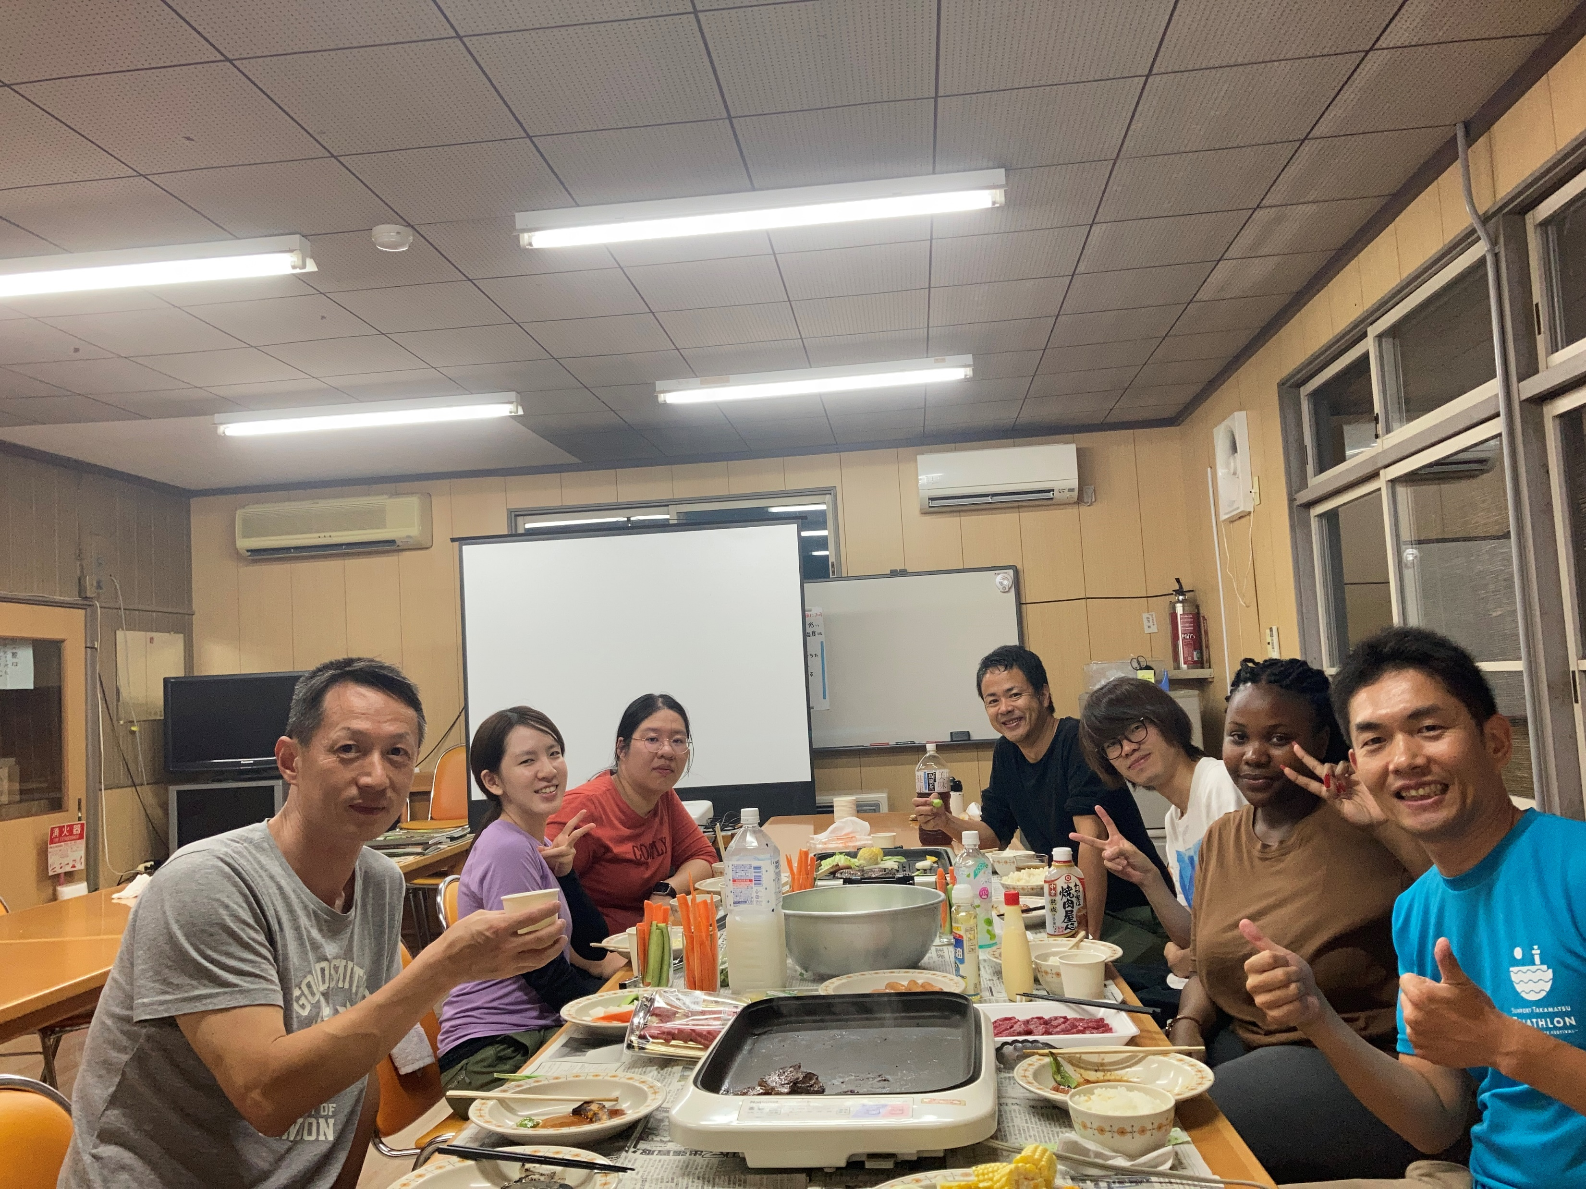
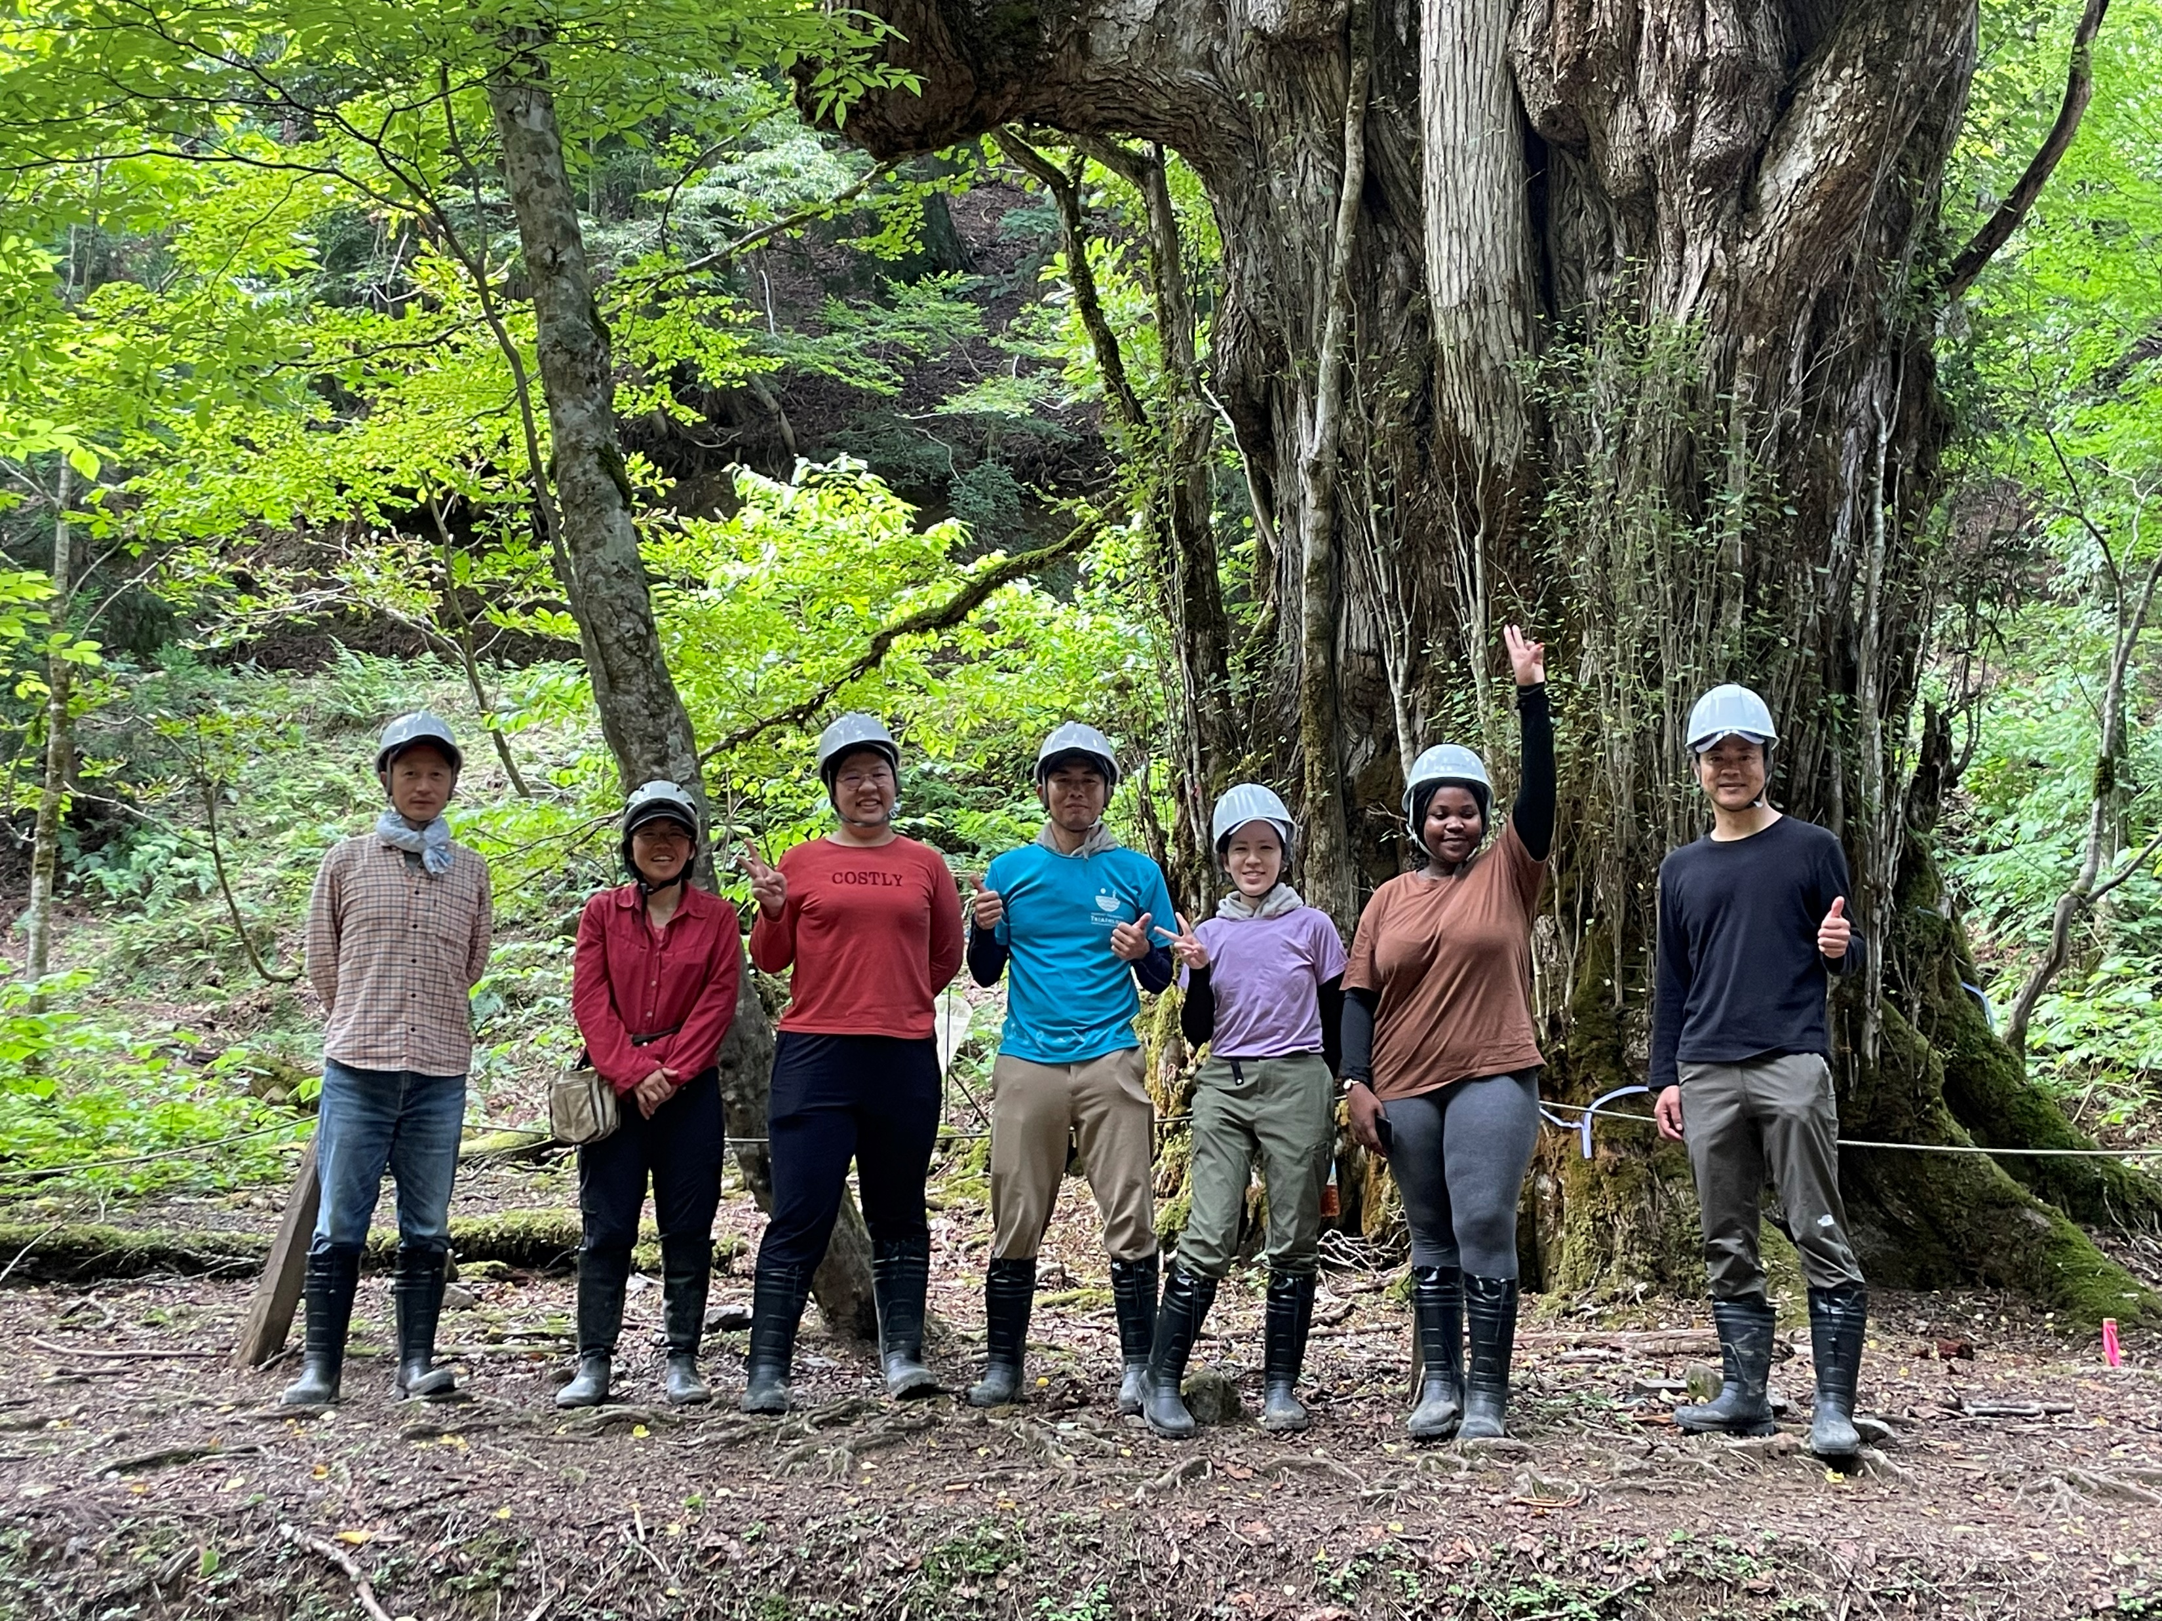
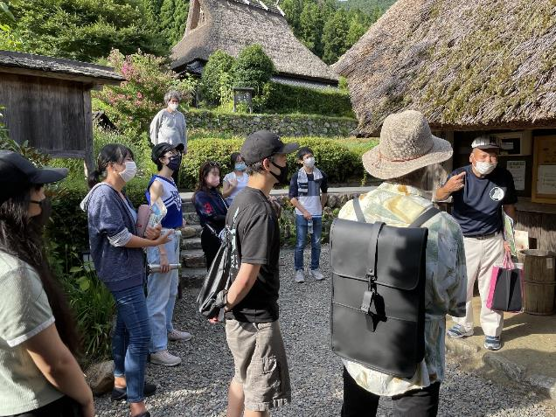
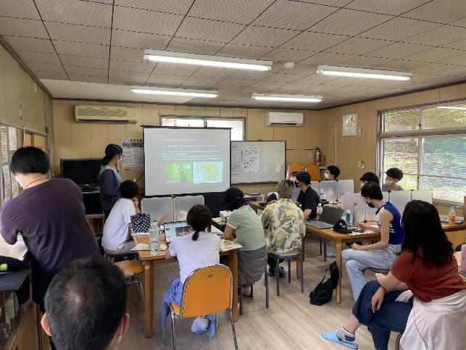
Other information
Theme: Coexistence of humans and nature
Out-of-pocket expense: about 7,000 Yen (meal, travel, etc)
Pre-study: 3-4 sessions in Oct and Nov (TBD) including orientation, lecture, group work, presentation, etc
Final presentation and term paper: Dec 25th, 2024 (tentative)

