Slide 1
Introduction and Schedule for Seminar II and Seminar III
Yanghepu Li
2022/04/08

Slide 2
The Time Schedule for All Seminars
 | Monday | Tuesday | Wednesday | Thursday | Friday
8 am – 10 am
10 am – 12 pm |  |  | Seminar II
2 pm – 4 pm |  |  |  |  | Group Meeting
4 pm – 6 pm
8 pm – 10 pm |  |  | Seminar III
Principle: each person of our group will present one time at each seminar (if needed) per month

Slide 3
Schedule for Group Meeting
 | 1st meeting | 2nd meeting | 3rd meeting | 4th meeting
April | 4/09 Introduction | 4/15 Yanghepu Li Yining Xu | 4/22 Rimsa Goperma Zhenyu Zuo
May | 5/06 Wenruo Lyu Rojan Basnet | 5/20 Yanghepu Li Yining Xu | 5/27 Rimsa Goperma Zhenyu Zuo
June | 6/03 Wenruo Lyu Rojan Basnet | 6/17 Yanghepu Li Yining Xu | 6/24 Rimsa Goperma Zhenyu Zuo
July | 7/01 Wenruo Lyu Rojan Basnet | 7/08 Yanghepu Li Yining Xu | 7/15 Rimsa Goperma Zhenyu Zuo | 7/22 Wenruo Lyu Rojan Basnet

Slide 4
Schedule for Seminar III
Schedule for Seminar II
 | 1st meeting | 2nd meeting | 3rd meeting | 4th meeting
April | 4/13 Zhenyu Zuo | 4/20 Yanghepu Li | 4/27 Wenruo Lyu
 | 1st meeting | 2nd meeting | 3rd meeting | 4th meeting
April | 4/13 Trial | 4/20 Yanghepu Li Yining Xu | 4/27 Rojan Basnet Zhenyu Zuo

Slide 5
What is Seminar II?
Seminar II (Reading Seminar) will be held 3 times a month, aimed to share and discuss what we are reading and learning recently in our group. One presenter each time for about 1 hour and a half.
The learning materials will focus on graph learning in the first term, and computer vision (image processing) in the second term.
Material:
Hamilton, W. L. (2020). Graph representation learning. Synthesis Lectures on Artifical Intelligence and Machine Learning, 14(3), 1-159.

Slide 6
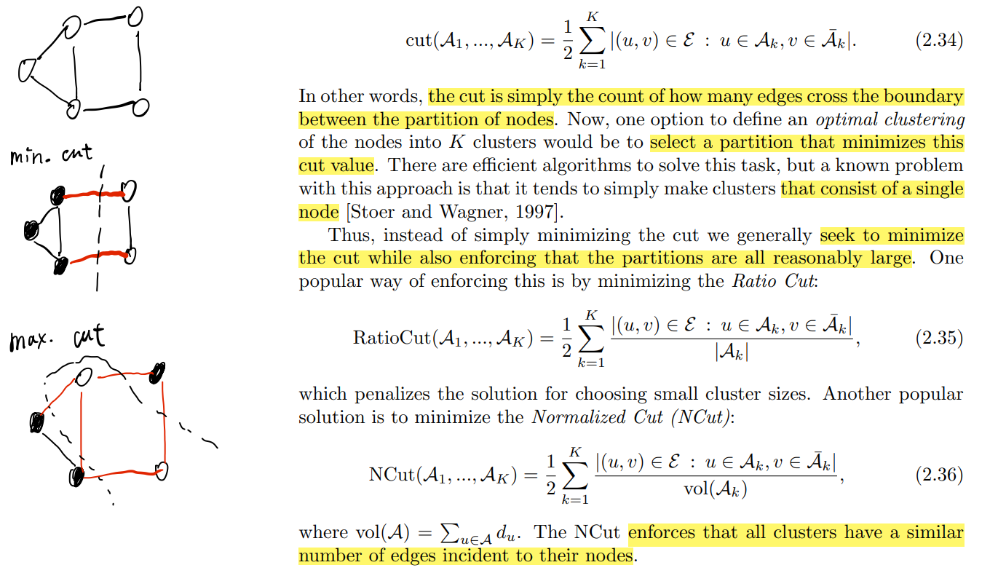
How to present on Seminar II?
Critical Thinking + Highlight + Handwriting
Critical thinking: fully think about and understand the contents so that you can fluently share with other students. If there is some questions, please write down and discuss them on the seminar
Highlight: highlight critical parts in the contents for better and easier understanding for others
Handwriting: for those not easy to understand or lack some prior knowledge, please search for and plus some materials by handwriting

Slide 7
What is Seminar III?
Seminar III (Machine Learning Seminar) will be held 4 times a month, only for 1st and 2nd year students, aiming to improve our knowledge and understanding about ML.
Two presenters each time, each one 40 minutes to 1 hour.
The contents should be basic machine learning knowledge (both theory and coding).

Slide 8
How to present on Seminar III?
Markdown+ Image + Code
Google Colab is a cloud Jupyter Notebook provided by Google Research. It is easy to use for machine learning education for both theory and learning.
Markdown is a common-used language in ML for text writer. It can be used to write down introductory contents and theoretical knowledge.
If Markdown cannot meet your needs for writing, images can be added to help illustrate.
For coding, Colab provides free GPU/CPU to use, and it is easy for others to re-run your code.
Common account: futurewisdomseminar@gmail.com
Passport: onlyforseminariii

Slide 9
Thanks you!

